Slide 1


SUMMER RETREAT
JULY 2026

Slide 2
INTRODUCTION
Today we’re choosing not to leave change to chance. We’re activating it!

Slide 3

KICK OFF ICEBREAKER
3

Slide 4
GET INTO TEAMS
4

Slide 5
TRIVIA QUESTION #1
People still refer to the Day Program at our Audubon Campus on North Forest Road as “Brock.” Where did the name Brock come from?

Slide 6
TRIVIA QUESTION #1: Multiple Choice
People still refer to the Day Program at our Audubon Campus on North Forest Road as “Brock.” Where did the name Brock come from?
Walter Brock, long-time board member at Aspire of WNY.
Sandra Brock, one of the original participants in our day program.
Brock Construction, the company that funded the renovation of our Day Program space.

Slide 7
TRIVIA QUESTION #1: ANSWER
People still refer to the Day Program at our Audubon Campus on North Forest Road as “Brock.” Where did the name Brock come from?
Walter Brock, long-time board member at Aspire of WNY.
Sandra Brock, one of the original participants in our day program.
Brock Construction, the company that funded the renovation of our Day Program space.

Slide 8
TRIVIA QUESTION #2
What year was Aspire of WNY
(formerly United Cerebral Palsy Association of WNY) formed?

Slide 9
TRIVIA QUESTION #2: Multiple Choice
What year was Aspire of WNY (formerly United Cerebral Palsy Association of WNY) formed?
1942
1945
1947

Slide 10
TRIVIA QUESTION #2: ANSWER
What year was Aspire of WNY (formerly United Cerebral Palsy Association of WNY) formed?
1942
1945
1947

Slide 11
TRIVIA QUESTION #3
What was the name of the first adult residence
operated by Aspire of WNY?

Slide 12
TRIVIA QUESTION #3: Multiple Choice
What was the name of the first adult residence operated by Aspire of WNY?
West Huron Steet Adult Care Facility on West Huron in Buffalo
Crippled Children’s Guild Home on North Street in Buffalo
Elmer Lux Hostel on Habert Street in Buffalo

Slide 13
TRIVIA QUESTION #3: ANSWER
What was the name of the first adult residence operated by Aspire of WNY?
West Huron Steet Adult Care Facility on West Huron in Buffalo
Crippled Children’s Guild Home on North Street in Buffalo
Elmer Lux Hostel on Habert Street in Buffalo

Slide 14
TRIVIA QUESTION #4
Just before it was converted into “The Training Academy” what Aspire of WNY program operated out of the location at 2360 B North Forest Road behind our administration building?

Slide 15
TRIVIA QUESTION #4: Multiple Choice
Just before it was converted into “The Training Academy” what Aspire of WNY program operated out of the location at 2360 B North Forest Road behind our administration building?
The first children’s ICF operated by Aspire of WNY.
The Free-Standing Respite Program.
The original Audubon Adult IRA.

Slide 16
TRIVIA QUESTION #4: ANSWER
Just before it was converted into “The Training Academy” what Aspire of WNY program operated out of the location at 2360 B North Forest Road behind our administration building?
The first children’s ICF operated by Aspire of WNY.
The Free-Standing Respite Program.
The original Audubon Adult IRA.

Slide 17
TRIVIA QUESTION #5
What year did Aspire of WNY’s corporate headquarters on Mall Boulevard in Lakewood New York open for business?

Slide 18
TRIVIA QUESTION #5: Multiple Choice
What year did Aspire of WNY’s corporate headquarters on Mall Boulevard in Lakewood New York open for business?
2002
2005
2010

Slide 19
TRIVIA QUESTION #5: ANSWER
What year did Aspire of WNY’s corporate headquarters on Mall Boulevard in Lakewood New York open for business?
2002
2005
2010

Slide 20
TRIVIA QUESTION #6
What was the original name of the Aspire of WNY logo “Spirit”?

Slide 21
TRIVIA QUESTION #6: Multiple Choice
What was the original name of the Aspire of WNY logo “Spirit”?
Archie
Aspen
Andre

Slide 22
TRIVIA QUESTION #6: ANSWER
What was the original name of the Aspire of WNY logo “Spirit”?
Archie
Aspen
Andre

Slide 23
TRIVIA QUESTION #7
What are the theme colors on the clinic side at 7 Community Drive?

Slide 24
TRIVIA QUESTION #7: Multiple Choice
What are the theme colors on the clinic side at 7 Community Drive?
Blue and Green
Purple and Green
Yellow and Green

Slide 25
TRIVIA QUESTION #7: ANSWER
What are the theme colors on the clinic side at 7 Community Drive?
Blue and Green
Purple and Green
Yellow and Green

Slide 26
TRIVIA QUESTION #8
What year did Aspire of WNY (formerly United Cerebral Palsy Association of WNY) open its educational service division?

Slide 27
TRIVIA QUESTION #8: Multiple Choice
What year did Aspire of WNY (formerly United Cerebral Palsy Association of WNY) open its educational service division?
1951
1958
1962

Slide 28
TRIVIA QUESTION #8: ANSWER
What year did Aspire of WNY (formerly United Cerebral Palsy Association of WNY) open its educational service division?
1951
1958
1962

Slide 29
TRIVIA QUESTION #9
Who were the founders of Aspire of WNY (formerly United Cerebral Palsy Association of WNY)?

Slide 30
TRIVIA QUESTION #9: Multiple Choice
Who were the founders of Aspire of WNY (formerly United Cerebral Palsy Association of WNY)?
Board members of Children’s Hospital in Buffalo
The John Oishei Foundation
Parents of those with Cerebral Pasly

Slide 31
TRIVIA QUESTION #9: ANSWER
Who were the founders of Aspire of WNY (formerly United Cerebral Palsy Association of WNY)?
Board members of Children’s Hospital in Buffalo
The John Oishei Foundation
Parents of those with Cerebral Pasly

Slide 32
TRIVIA QUESTION #10
What was the very first staffing model in adult residential services?

Slide 33
TRIVIA QUESTION #10: Multiple Choice
What was the very first staffing model in adult residential services?
Live in “House parents”
Volunteer family members.
24-hour nursing care

Slide 34
TRIVIA QUESTION #10: ANSWER
What was the very first staffing model in adult residential services?
Live in “House parents”
Volunteer family members.
24-hour nursing care

Slide 35
TRIVIA QUESTION #11
What building was generously donated to Aspire of WNY and will become the location of our new corporate headquarters in Fredonia?

Slide 36
TRIVIA QUESTION #11: Multiple Choice
What building was generously donated to Aspire of WNY and will become the location of our new corporate headquarters in Fredonia?
The WBA on Church Street in Fredonia
The WDA on Center Street in Fredonia
The WCA on Temple Street in Fredonia

Slide 37
TRIVIA QUESTION #11: ANSWER
What building was generously donated to Aspire of WNY and will become the location of our new corporate headquarters in Fredonia?
The WBA on Church Street in Fredonia
The WDA on Center Street in Fredonia
The WCA on Temple Street in Fredonia

Slide 38
TRIVIA QUESTION #12
What is currently the “official font” of Aspire of WNY?

Slide 39
TRIVIA QUESTION #12: Multiple Choice
What is currently the “official font” of Aspire of WNY?
Aptos 12
Currier 12
Comic Sans 14

Slide 40
TRIVIA QUESTION #12: ANSWER
What is currently the “official font” of Aspire of WNY?
Aptos 12
Currier 12
Comic Sans 14

Slide 41
TRIVIA QUESTION #13
In what decade did Aspire of WNY (formerly United Cerebral Palsy Association of WNY) open its outpatient clinical services program?

Slide 42
TRIVIA QUESTION #13: Multiple Choice
In what decade did Aspire of WNY (formerly United Cerebral Palsy Association of WNY) open its outpatient clinical services program?
1960s
1970s
1980s

Slide 43
TRIVIA QUESTION #13: ANSWER
In what decade did Aspire of WNY (formerly United Cerebral Palsy Association of WNY) open its outpatient clinical services program?
1960s
1970s
1980s

Slide 44
TRIVIA QUESTION #14
Before it was called “Day Habilitation,” what were site-based day service programs referred to by our state oversight agency?

Slide 45
TRIVIA QUESTION #14: Multiple Choice
Before it was called “Day Habilitation,” what were site-based day service programs referred to by our state oversight agency?
Day Training Centers
Day Treatment Centers
Day Health Care Centers

Slide 46
TRIVIA QUESTION #14: ANSWER
Before it was called “Day Habilitation,” what were site-based day service programs referred to by our state oversight agency?
Day Training Centers
Day Treatment Centers
Day Health Care Centers

Slide 47
TRIVIA QUESTION #15
Just before Service Coordination transitioned to Care Coordination, what location housed the Aspire of WNY Service Coordination Department?

Slide 48
TRIVIA QUESTION #15: Multiple Choice
Just before Service Coordination transitioned to Care Coordination, what location housed the Aspire of WNY Service Coordination Department?
The Tri Main building on Main Street in Buffalo
7 Community Drive in Cheektowaga
The Audubon Administration Building on North Forest in Getzville

Slide 49
TRIVIA QUESTION #15: ANSWER
Just before Service Coordination transitioned to Care Coordination, what location housed the Aspire of WNY Service Coordination Department?
The Tri Main building on Main Street in Buffalo
7 Community Drive in Cheektowaga
The Audubon Administration Building on North Forest in Getzville

Slide 50
TRIVIA QUESTION #16
From its origin in the 1940s until 1965, Aspire of WNY supported children and adults with which primary developmental diagnosis?

Slide 51
TRIVIA QUESTION #16: Multiple Choice
From its origin in the 1940s until 1965, Aspire of WNY supported children and adults with which primary developmental diagnosis?
Down Syndrome
Cerebral Pasly
Epilepsy

Slide 52
TRIVIA QUESTION #16: ANSWER
From its origin in the 1940s until 1965, Aspire of WNY supported children and adults with which primary developmental diagnosis?
Down Syndrome
Cerebral Palsy
Epilepsy

Slide 53
TRIVIA QUESTION #17
In early 2026, the Cheektowaga campus of Aspire of WNY at 7 Community Drive expanded with the purchase of which new location?

Slide 54
TRIVIA QUESTION #17: Multiple Choice
In early 2026, the Cheektowaga campus of Aspire of WNY at 7 Community Drive expanded with the purchase of which new location?
120 Old Maryvale Drive (the former Mother of Devine Grace Church)
409 Maryvale Drive (WNY Imaging, the former B-Quik location)
425 Maryvale (the former Maryvale Presbyterian Church)

Slide 55
TRIVIA QUESTION #17: ANSWER
In early 2026, the Cheektowaga campus of Aspire of WNY at 7 Community Drive expanded with the purchase of which new location?
120 Old Maryvale Drive (the former Mother of Devine Grace Church)
409 Maryvale Drive (WNY Imaging, the former B-Quik location)
425 Maryvale (the former Maryvale Presbyterian Church)

Slide 56
TRIVIA QUESTION #18
What are the Aspire of WNY trademark colors?

Slide 57
TRIVIA QUESTION #18: Multiple Choice
What are the Aspire of WNY trademark colors?
Teal and Yellow
Teal and Green
Black and yellow

Slide 58
TRIVIA QUESTION #18: ANSWER
What are the Aspire of WNY trademark colors?
Teal and Yellow
Teal and Green
Black and yellow

Slide 59
TRIVIA QUESTION #19
In what year did United Cerebral Palsy Association of WNY officially change its name to Aspire of WNY?

Slide 60
TRIVIA QUESTION #19: Multiple Choice
In what year did United Cerebral Palsy Association of WNY officially change its name to Aspire of WNY?
2000
2003
2007

Slide 61
TRIVIA QUESTION #19: ANSWER
In what year did United Cerebral Palsy Association of WNY officially change its name to Aspire of WNY?
2000
2003
2007

Slide 62
TRIVIA QUESTION #20
What Aspire of WNY service division was previously affiliated with Spoke Folk in Dunkirk New York?

Slide 63
TRIVIA QUESTION #20: Multiple Choice
What Aspire of WNY service division was previously affiliated with Spoke Folk in Dunkirk New York?
Residential Services
Educational Services
Community and Independent Living Supports

Slide 64
TRIVIA QUESTION #20: ANSWER
What Aspire of WNY service division was previously affiliated with Spoke Folk in Dunkirk New York?
Residential Services
Educational Services
Community and Independent Living Supports

Slide 65
TRIVIA QUESTION #21
What was the name of the former day care center housed at Aspire of WNY’s Center for Learning?

Slide 66
TRIVIA QUESTION #21: Multiple Choice
What was the name of the former day care center housed at Aspire of WNY’s Center for Learning?
Candyland Day Care Center
Aspiring Tots
Children’s Discovery Corner

Slide 67
TRIVIA QUESTION #21: ANSWER
What was the name of the former day care center housed at Aspire of WNY’s Center for Learning?
Candyland Day Care Center
Aspiring Tots
Children’s Discovery Corner

Slide 68
TRIVIA QUESTION #22
What year will mark Aspire of WNY’s 80th anniversary?

Slide 69
TRIVIA QUESTION #22: Multiple Choice
What year will mark Aspire of WNY’s 80th anniversary?
2027
2029
2032

Slide 70
TRIVIA QUESTION #22: ANSWER
What year will mark Aspire of WNY’s 80th anniversary?
2027
2029
2032

Slide 71
TRIVIA QUESTION #23
Which 2 Aspire of WNY residential settings are non-certified?

Slide 72
TRIVIA QUESTION #23: Multiple Choice
Which two Aspire of WNY residential settings are non-certified?
Cushing and High Park
Westside and Wehrle
Kenmore and Sheridan

Slide 73
TRIVIA QUESTION #23: ANSWER
Which two Aspire of WNY residential settings are non-certified?
Cushing and High Park
Westside and Wehrle
Kenmore and Sheridan

Slide 74
TRIVIA QUESTION #24
Which of the following is NOT one of the goal areas of Aspire of WNY’s current strategic plan?

Slide 75
TRIVIA QUESTION #24: Multiple Choice
Which of the following is NOT one of the goal areas of Aspire of WNY’s current strategic plan?
Operational Excellence
Information Capital
Climate Control

Slide 76
TRIVIA QUESTION #24: ANSWER
Which of the following is NOT one of the goal areas of Aspire of WNY’s current strategic plan?
Operational Excellence
Information Capital
Climate Control

Slide 77
TRIVIA QUESTION #25
What are Aspire of WNY’s values?

Slide 78
TRIVIA QUESTION #25: Multiple Choice
What are Aspire of WNY’s values?
Rights, Recognition, and Resilience
People, Performance, and Partnerships
Inspiration, Independence, and Innovation

Slide 79
TRIVIA QUESTION #25: ANSWER
What are Aspire of WNY’s values?
Rights, Recognition, and Resilience
People, Performance, and Partnerships
Inspiration, Independence, and Innovation

Slide 80
Today’s Focus: Culture
Why Culture Matters
  Decades of organizational science and research show that a strong culture—one that is aligned, accountable, and engaged—is the binding ingredient for any successful workplace.
  Culture increases retention, builds resilience, and drives the strategic results we need to better support the people we serve and our Aspire of WNY team members.

Slide 81
BUT FIRST…
What is culture?
We need a common definition to ensure we’re on the same page.

Slide 82
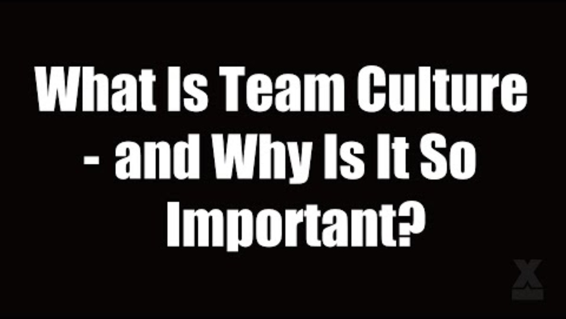

Slide 83
DISCUSSION
What is something new you learned about culture that you didn’t know before?

Slide 84
IMPACT OF CULTURE BREAKDOWN
84

Slide 85
AMAZING WORKPLACE OVERVIEW | 2026 & COMPARED RESULTS
534 (33%) Employees Completed the Survey in March 2026
2%
Very Unhappy
5%
Unhappy
11%
Unsatisfied
30%
Satisfied
38%
Happy
15%
Very Happy
Survey Category | July 2024 | June 2025 | March 2026 | 2-Year Change
Empowerment | 70% | 51% | 49% | -21%
Safety | 83% | 58% | 56% | -27%
Belonging | 73% | 58% | 56% | -17%
Enjoyment | 74% | 57% | 54% | -20%
Growth | 58% | 49% | 43% | -15%
Rewards | 44% | 38% | 35% | -9%
Communication | 43% | 38% | 38% | -5%

Slide 86
AMAZING WORKPLACE OVERVIEW | 2026 & COMPARED RESULTS
While participation has remained steady, overall sentiment has shifted significantly since 2024.
  Participation Rate: Holding solid at 33% (534 employees responding in March 2026).
  "Very Happy & Happy" Employees: Dropped from 68.4% in 2024 to 52.4% in 2026.
  The Diagnostic: The platform marks Aspire of WNY as "Average"—noting that because less than 60% of our workforce falls into the happy tier, there is an immediate opportunity for cultural improvement.
CURRENT STRENGTHS
IMPROVE CULTURE + HAPPINESS
TRENDS TO TURN AROUND
56% Happy with Purpose
46% Love People They Work With
Community
Mission
Purpose
Experiences
Empowerment
Belonging
Workplace Safety
40% Shift in Focus:
From quantity to quality
19% Need Fewer Distractions
18%: Structural Clarity & Understanding Expectations

Slide 87
WORKFORCE STATISTICS
Applications
Month | 2025 | 2026
Jan | 852 | 658
Feb | 785 | 489
March | 600 | 732
April | 595 | 603
May | 612 | 706
June | 926 | 546
July | 693 | 72 (by 7/6/26)
Aug | 624
Sept | 881
Oct | 1000
Nov | 451
Dec | 759
Totals | 7944 | 3806
Timeframe | Hired | Terminated | Voluntary | Involuntary
1/25-6/25 | 364 | 280 | 229 | 51
7/25-12/25 | 329 | 325 | 264 | 61
1/26-6/26 | 307 | 318 | 251 | 67
Totals | 1000 | 923 | 744 (81%) | 179 (19%)
Analysis: When the culture formula breaks down, we lose great people. A deep dive into recent exit interview data reveals that
staff turnover is rarely just about "finding a new job"—it is closely tied to systemic breakdowns in communication, recognition, and management support across our divisions.

Slide 88
EXIT INTERVIEW ANALYSIS: Core Cultural Breakdowns
Work-Life Balance & Burnout: Multiple team members noted an unsustainable pace and lack of support.
Lack of Appreciation & Support: A recurring sentiment that leadership fails to validate hard work or listen to employee feedback.
Stalled Professional Growth: Employees expressing frustration over dead-end roles and an inability to advance internally.
Inconsistent Feedback & Training: A direct link between poor onboarding/supervision and early departures.
"Not a good work place no work life balance"
“No appreciation or respect”
Zero communication and no one treated equally
"Trying to move up with this company is hard so that’s why I decided to look for a better opportunities"
"I never did receive direct reports or evals to help with direction… my position required time to be trained, clarity, teaching and feedback but I didn’t experience that."

Slide 89
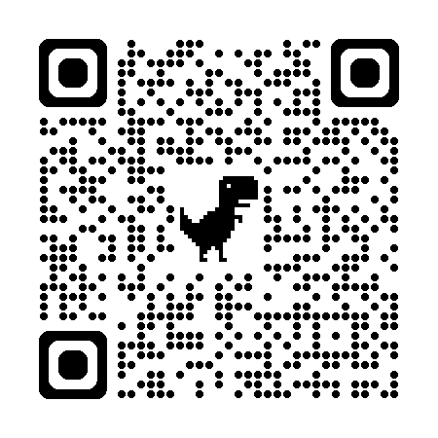
STATE OF CULTURE:
What words do you think best describe Aspire of WNY’s current culture?
Scan the QR Code to Take the Poll
89

Slide 90
REVIEW RESULTS & DISCUSS
90

Slide 91
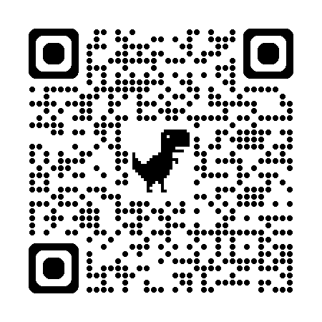
FUTURE OF CULTURE:
What words do you think best describe where we want Aspire of WNY’s culture to go?
Scan the QR Code to Take the Poll
91

Slide 92
REVIEW RESULTS & DISCUSS
92

Slide 93
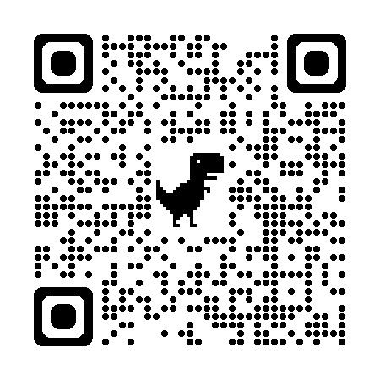
The How:
How will we begin to achieve our
new collective culture?
Scan the QR Code to Take the Poll
93

Slide 94
REVIEW RESULTS & DISCUSS
94

Slide 95


Slide 96
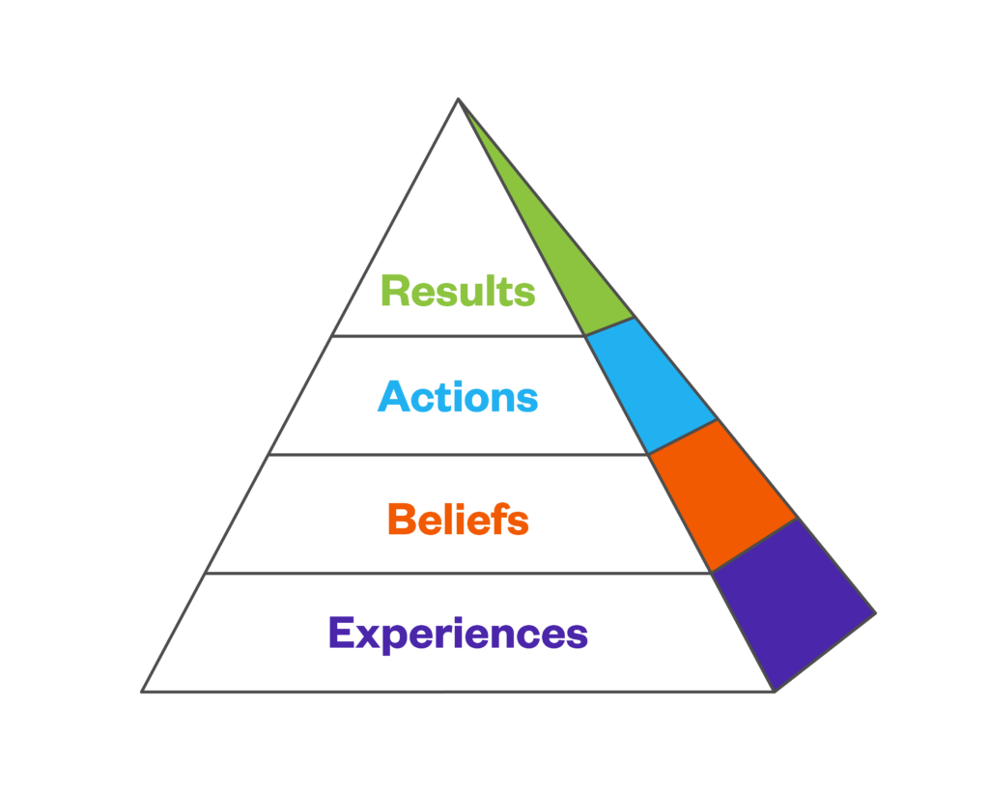
Culture into Action: Pyramid + Formula
Experiences (The Input): Every single interaction, communication style, or leadership decision creates a tangible event. These are the everyday inputs we control or influence.
Beliefs (The Alignment): Those experiences directly shape the internal conclusions our staff draw about their value and purpose at Aspire of WNY.
Actions (The Execution): Once a belief is internalized, it naturally dictates an employee's intentions and daily behaviors. You cannot sustainably change actions without shifting the underlying belief.
Results (The Outcome): The sum of all employee actions directly yields our final organizational outcomes—from staff retention rates to the quality of care we provide.

Slide 97
"I never did receive direct reports or evals to help with direction… my position required time to be trained, clarity, teaching and feedback but I didn’t experience that."
"Trying to move up with this company is hard so that’s why I decided to look for a better opportunities"
"Not a good work place no work life balance"
“No appreciation or respect”
Zero communication and no one treated equally
The Experience: Poor communication, lack of training, and structural favoritism.
The Belief: "My voice doesn't matter here, I am not appreciated, and I have no future at this agency.“
The Action: Disengagement, burnout, and ultimately submitting a resignation.
The Result: A loss of institutional knowledge, high turnover costs, and disrupted continuity of care for the individuals we serve.
We need to work together to shift the beliefs to get the actions and results that we want in the culture we are creating together!

Slide 98
ACTIVITY:
Turning Our Future Culture Top 10
Into Actions
98

Slide 99
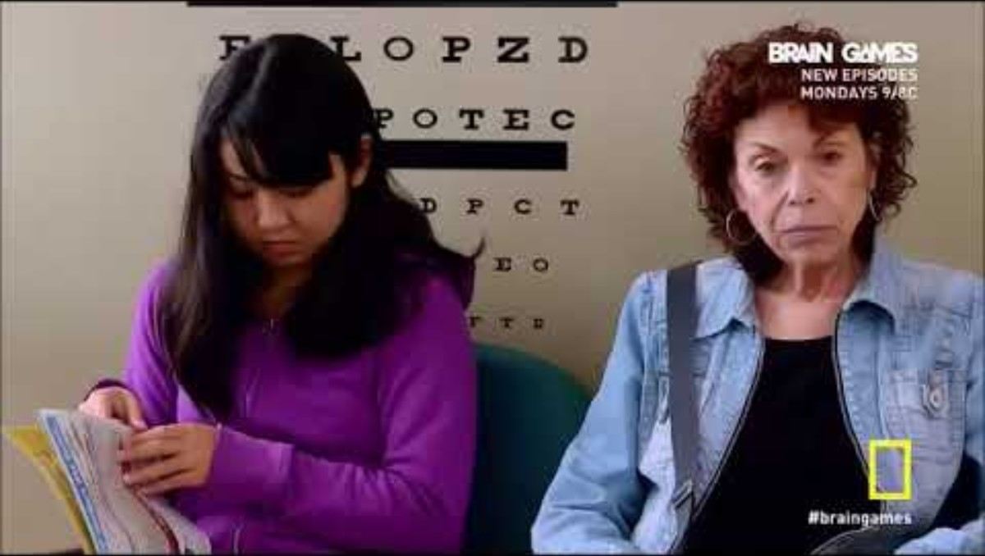

Slide 100
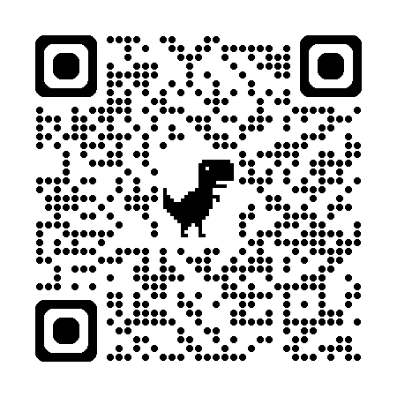
OASIS PORTAL + HOMEWORK
This is about today AND
all of our tomorrows.
SCAN TO ACCESS PORTAL
The Manual of Me Assignment
See handout
A personal user manual is a short, structured guide that introduces your unique working style, preferences, values, and communication needs to your team.
It removes the guesswork from collaboration and fast-tracks psychological safety within your department.
Helps with self-awareness, invisible alignment, and reducing friction between employees, teams, and all levels of an organization
HOMEWORK: Go on the online portal and submit the results of your worksheet so we can look at our group “Manuals of Me” for the next session. Other questions will also be on the homework assignment to guide you and your team for next steps. Due by July 31st, 2026.

Slide 101
THANK YOU!

